Slide 1
Exploring restaurants from the main regions of São Paulo, using Zomato dataset
Zomato dataset from Kaggle
https://www.kaggle.com/shrutimehta/zomato-restaurants-data/data?select=zomato.csv

Slide 2
Introduction
São Paulo is a municipality in the Southeast Region of Brazil. The metropolis is an alpha global city (as listed by the GaWC) and the most populous city in Brazil, the Americas, the Western Hemisphere and the Southern Hemisphere. Additionally, São Paulo is the largest Portuguese-speaking city in the world. The municipality is also the world's 4th largest city proper by population. The city is the capital of the surrounding state of São Paulo, the most populous and wealthiest state in Brazil. It exerts strong international influences in commerce, finance, arts and entertainment. The name of the city honors the Apostle, Saint Paul of Tarsus. The city's metropolitan area, the Greater São Paulo, ranks as the most populous in Brazil and the 12th most populous on Earth.
São Paulo is considered the most multicultural city in Brazil. Since 1870 to 2010, approximately 2.3 million immigrants arrived in the state, from all parts of the world. The Italian community is one of the strongest, with a presence throughout the city. Of the 9 million inhabitants of São Paulo, 50% (4.5 million people) have full or partial Italian ancestry. São Paulo has more descendants of Italians than any Italian city (the largest city of Italy is Rome, with 2.5 million inhabitants).
The cuisine of São Paulo is a tourist attraction. The city has 62 cuisines across 12,000 restaurants. During the 10th International Congress of Gastronomy, Hospitality and Tourism (Cihat) conducted in 1997, the city received the title of "World Gastronomy Capital" from a commission formed by 43 nations' representatives.
As part of this project, we will explore restaurants from the main regions of São Paulo, focusing on Italian cuisine. The outcome of this project will be useful for those interested on knowing more about the gastronomic environment in the city.

Slide 3
Objectives
Provide answers to the following questions:
What localities have the largest number of rated restaurants in the main regions of São Paulo ?
What localities have the smallest number of rated restaurants in the main regions of São Paulo ?
What localities have the best rated restaurants in the main regions of São Paulo ?
What localities have the worst rated restaurants in the main regions of São Paulo ?
What localities have the largest number of rated Italian restaurants in the main regions of São Paulo ?
What localities have the best rated Italian restaurants in the main regions of São Paulo ?
What localities have more nearby venues with Italian restaurants ?

Slide 4
Data
For this project, the following data will be used:
Data from restaurants situated at the main regions of São Paulo, including Locality, Cuisines, Restaurant Names, Rating, Latitude, Longitude, etc.
Data source: Zomato kaggle dataset. Description: This dataset contains the required information to explore various localities of São Paulo.
Nearby places in each locality of the main regions of São Paulo:
Data source: Foursquare API. Description: By using this API we will get all the venues in each neighborhood.

Slide 5
Methodology
Collect restaurants data from Zomato Kaggle dataset.
Clean up data.
Visualize data using Folium Python library.
Generate plots to compare each locality with regards to restaurants.
Group data based on locality.
Use Foursquare API to find all venues for each neighborhood.
Filter out all nearby venues by locality.
Use aggregate rating from each restaurant to find the best places.
Run k-means to cluster the localities into 5 clusters.

Slide 6
Results

Slide 7
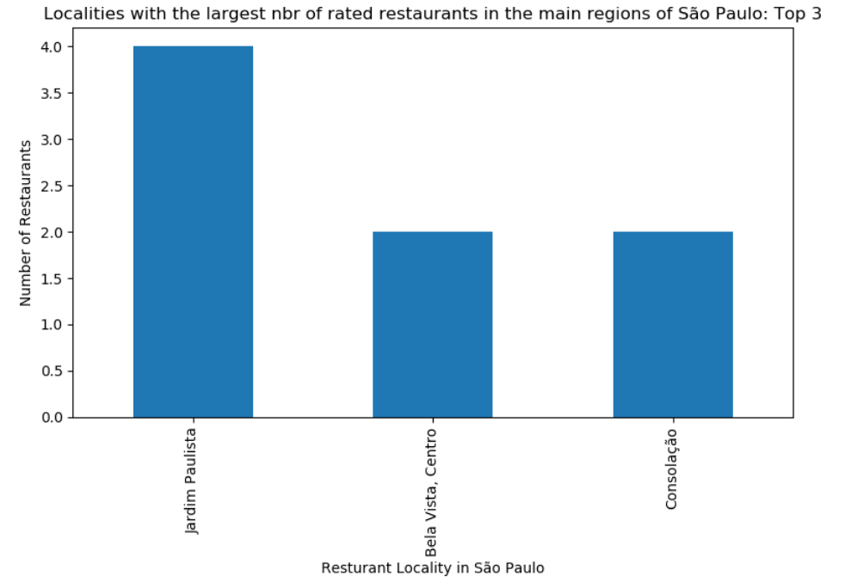

Slide 8
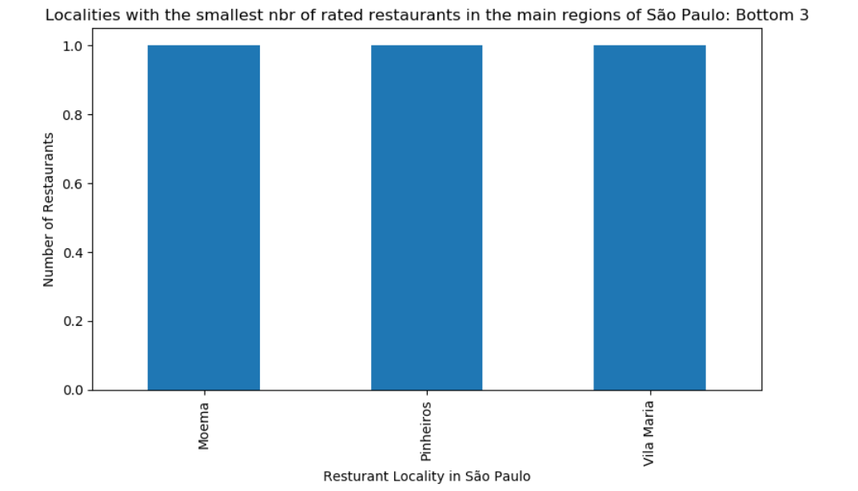

Slide 9
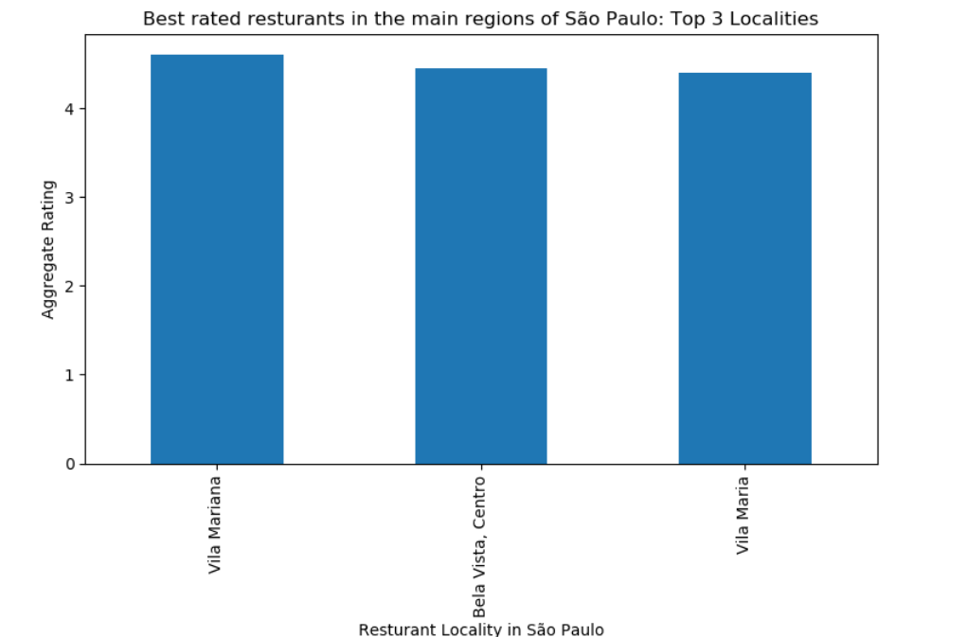

Slide 10
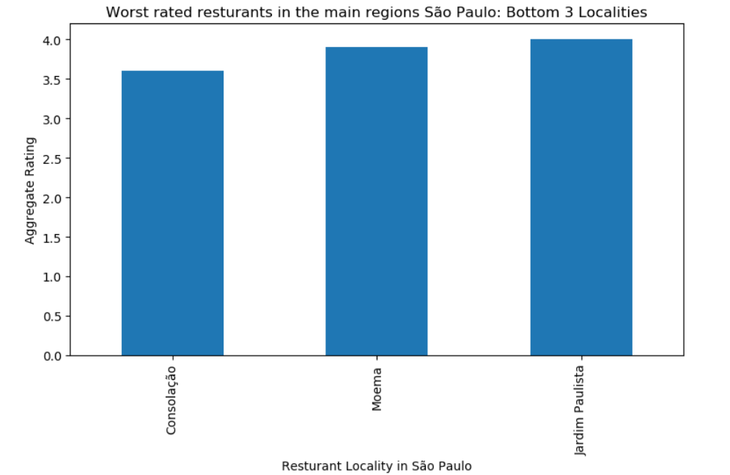

Slide 11
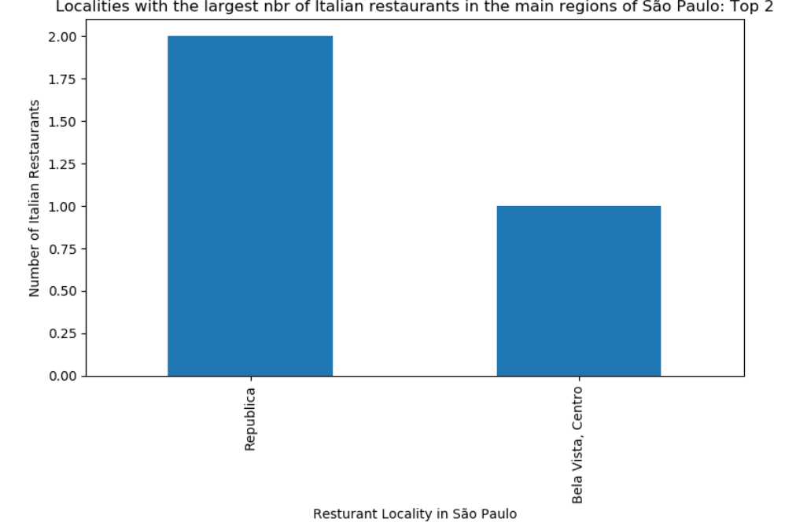

Slide 12
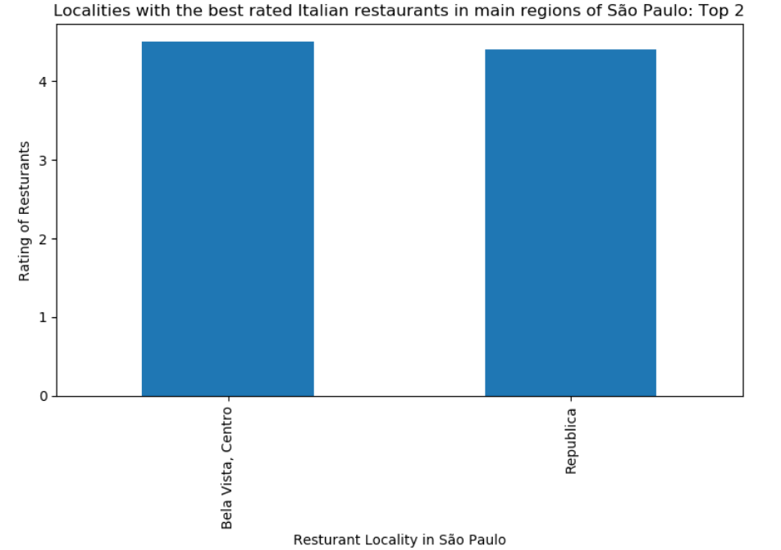

Slide 13
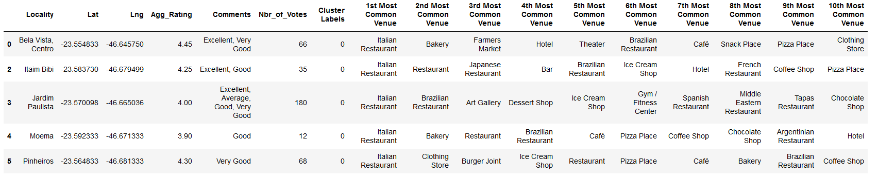
Cluster 1 (Bela Vista, Itaim Bibi, Jardim Paulista, Moema, Pinheiros): it is most recommended for Italian Restaurant

Slide 14
Cluster 2 (Vila Maria): it is most recommended for Market, Pizza and Brazilian Restaurant

Slide 15
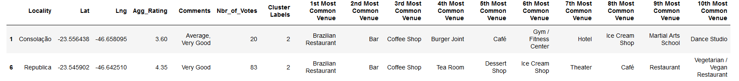
Cluster 3 (Consolação, Republica): it is most recommended for Brazilian Restaurant, Bar and Coffee Shop

Slide 16
Cluster 4 (Vila Mariana): it is most recommended for Ice Cream, Pizza and Bakery

Slide 17
Cluster 5 (Vila Sonia): it is most recommended for Pet Store, Gym and Construction & Landscaping

Slide 18
Discussion
Based on the results obtained from Zomato dataset, we can notice that ‘Republica’ and ‘Bela Vista’ are the most recommended localities if you want to explore rated Italian restaurants in the main regions on São Paulo. On the other hand, if we consider the nearby venues given by the Foursquare API, ‘Bela Vista’, ‘Itaim Bibi’, ‘Jardim Paulista’, ‘Moema’ e ‘Pinheiros’ are the most recommended localities to find Italian restaurants.

Slide 19
Conclusion
Considering the main regions of São Paulo:
Jardim Paulista, Bela Vista and Consolação are the localities with the largest nbr of rated restaurants.
Moema, Pinheiros and Vila Maria are the localities with the smallest nbr of rated restaurants.
Vila Mariana, Bela Vista and Vila Maria are the localities with the best rated restaurants.
Consolação, Moema and Jardim Paulista are the localities with the worst rated restaurants.
Republica and Bela Vista are the localities with the largest nbr of rated Italian restaurants.
Bela Vista and Republica are the localities with the best rated Italian restaurants.

Slide 20
Conclusion
Cluster 1 (Bela Vista, Itaim Bibi, Jardim Paulista, Moema, Pinheiros): it is most recommended for Italian Restaurant.
Cluster 2 (Vila Maria): it is most recommended for Market, Pizza and Brazilian Restaurant.
Cluster 3 (Consolação, Republica): it is most recommended for Brazilian Restaurant, Bar and Coffee Shop.
Cluster 4 (Vila Mariana): it is most recommended for Ice Cream, Pizza and Bakery.
Cluster 5 (Vila Sonia): it is most recommended for Pet Store, Gym and Construction & Landscaping.

